Slide 1
April 2018
2018 Co-OP Program for buying group Members

Slide 2

Welcome
Agenda
  Co-Op Overview
    Positioning
    Eligibility
    Highlight
    Process
    Guidelines
    Exceptions
    Q&A
  HPC Overview & Demo
Thank you for joining us
Notes:
Thank you for joining us and welcome to the 2018 Co-Op Overview for Buying Groups
First – some house rules:
We will record this session and it will be available for download on the Co-Op website
We have a lot to cover. Please hold questions until the end.
You can put questions into the IM section – we’ll track them and address them at the end.
If we don’t have time to answer all questions, we’ll follow up by email with answers.
This is the 1 of 2 sessions for members of buying groups
Intent is to provide you with an overview of the HIS 2018 Co-Op Program for Buying Groups
Additionally we will be providing you insight into a new service called Honeywell Partner Concierge.
You’ll see a brief overview of the topics we will discuss

Slide 3

Positioning
Significant annual investment in providing marketing support for Buying Group Members
Funds reserved for projects deemed by HIS to be:
  High Value / High Merit
  Aligned with HIS objectives and program guidelines
  Shows favorable ROI
Co-Op Program is a Strategic Growth Driver
Notes:
As we kick off these sessions, we want to first thank you for being a part of the partner program. We are a channel sales organization and we love and value our partners. We look forward to a long, healthy growing partnership.
To support this commitment, each year HIS invests a significant amount of dollars into the Co-Op program.
Co-Op is designed to help our distributors by supporting their marketing efforts, enabling them to do more, high quality marketing projects and drive more revenue through the channel.
HIS has to show a ROI for these funds. By doing so, it helps to pave the way for continuing programs like Co-Op in the future. That said – we all have an obligation to ensure that we use these funds on projects that are (address bullets).
We are working hard to ensure these funds are viewed by all as a strategy for driving growth, and not an entitlement

Slide 4

Buying Group Member Eligibility
Member Type | Free Assets | Free Customized Assets | Allowable Co-Op Funds | Marketing Plan Option
< $250K USD or <$100K CAD in prior fiscal year Sales with HIS
> $250K USD or >$100K CAD in prior fiscal year Sales with HIS
Benefits for all Buying Group Members
Notes:
All buying group members have access to download marketing collateral (assets) and have these assets customized for free with their logo and contact information with a new service being provided by Honeywell Partner Conceirge (HPC). More about that later.
Buying Group members have to meet an annual Dollar volume in Sales to earn Co-Op dollars. If your PY HIS sales were over $250K USD or $100K CAD – you have allowable Co-Op funds.
All buying Group members can submit an annual marketing plan instead of individual project requests to access Co-Op funds. We will provide more detail on that shortly too.

Slide 5

Understanding Allowable Co-Op Funds
Only available for Buying Group members that sell our General Safety & High Risk product Lines
Based on 1% of prior year sales (HIS Fiscal Year)
Funds are NOT guaranteed
  HIS has right to decline project requests, claims or limit partner allowable funds at any time
Can be used on approved marketing projects with Honeywell Partner Concierge (HPC) or with other 3rd Party Vendors
Funding period is January 1-December 31, 2018
Use it or lose it – unused funds will NOT roll over into the next calendar year
New Requirement for Allowable Co-Op Funds in 2019
  Buying Group Members that begin supplying monthly POS / INV data by Novermber1, 2018 will qualify for allowable funds in 2019
Know the Rules
Notes:
So let’s start by understanding what we mean by “Allowable Co-Op Funds”.
Every year we determine who meets the criteria for Co-Op, apply the 1% calculation to determine “allowable co-Op funds” and communicate available funds with the partners. If you’ve earned Co-Op funds, you’ll be hearing from us shortly regarding the amount.
It is important to note that these funds are not guaranteed and we have the right to decline project requests and/or claims at any time.
Once your project is approved, these funds can help offset the cost whether you implement with HPC or other 3rd party vendors.
Funding period is this calendar year…and if you have allowable funds at the end of the year, you CANNOT roll those funds into the next year. Use it or lose it.
One thing to note…there is a new requirement in 2018 for Buying Group Members. We are asking that all Buying Group Members start providing POS & Inventory data no later than November 1, 2018. If you do and you meet other 2019 program requirements – you will qualify for Co-Op funds in 2019. If you elect not to provide POS / inventory data by this date, you will lose access to Co-Op funds in 2019.

Slide 6

What Makes a Good Project?
Align with HIS Co-Op Program Guidelines
Deemed of High Value / High Merit
Shows desire and ability to drive incremental revenue for HIS and/or favorable ROI in the calendar year
Be a future activity
Desire and willingness to comply with Honeywell Brand Standards
Submitted at least 30 days prior to project execution and before 9/1/2018
Have target goals, metrics and ROI
Be executed in 2018
Putting the Right Foot Forward
Notes:
We want to spend a little time talking about what we look for in good, solid marketing project requests.
..address bullets.

Slide 7
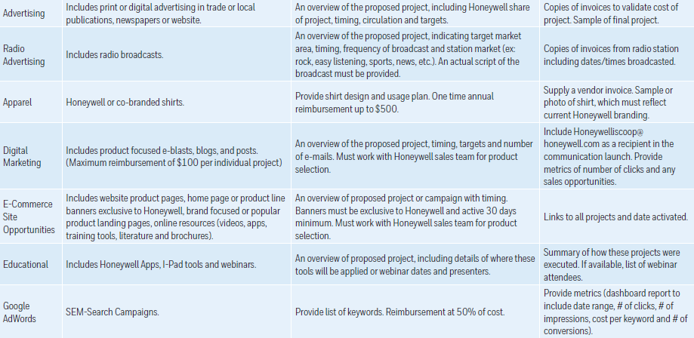
Guidelines
Additions
  Google Ad Words
  Point of Purchase Display Items
  Point of Sales (POS) and Inventory Data Reporting
Revisions
  Apparel – changed from collared shirt at 50% reimbursement up to $500 to any shirt one time annual reimbursement up to $500.
Downloadable version of the Guidelines available at:
  http://go.honeywellsafety.com/MAPform
We listened…and Modified!
Notes:
Each year we update our Program Guidelines. We want to spend a little time talking about projects that align with the guidelines and what is new this year.
In 2017, we conducted extensive VOC over the past year and we’ve heard what you said. You wanted things like Google AdWords added to the program. You want to be able to order PoP Display items with Co-Op dollars. So we added those back in. Because of the mandate to provide monthly POS and inventory data – we’ve also given you a one-time opportunity to use Co-Op dollars to fund getting your data into the right reporting structure to send to us!
We’ve also revised things like apparel orders. We used us limit the types of shirts you can buy. Now you can use up to $500/year to buy any Honeywell logoed apparel.
The image on the screen details types of projects, pre-approval requirements and Proof of Purchase Requirements. Please consult this guide for project ideas and to ensure your proposed projects meet the guidelines.

Slide 8
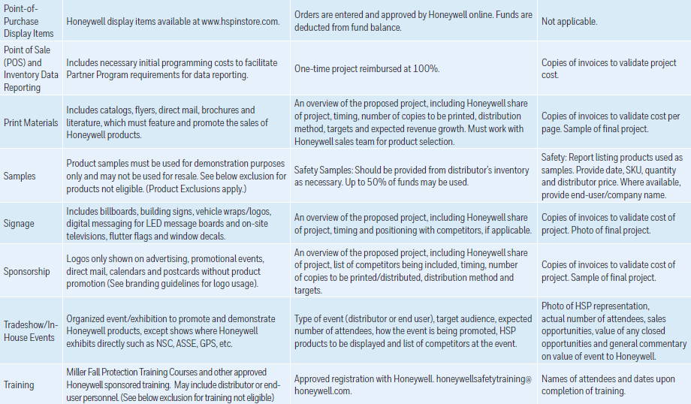
Guidelines Continued
Notes:
<Allow 30 seconds for people to review>

Slide 9
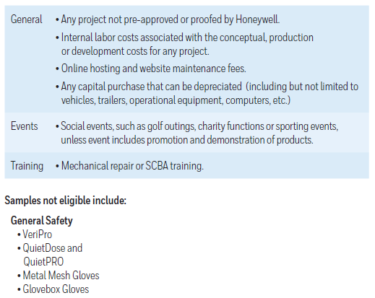

Exclusion
We Can’t Approve Everything…
Notes:
There are some things we just can’t authorize.
Internal labor costs with the conception, production or implementation of a project
Online hosting and website maintenance fees – these are viewed as your operational costs
Anything we deem as a Capitol expenditure that you can depreciate
Social events that don’t involve our ability to promote and demonstrate products
Specific training classes as detailed here
Specific samples as detailed here

Slide 10
UNDERSTANDING THE BRAND
Honeywell has a proud history and is well-known throughout the world. With its instant brand recognition and equity, the distinctive red logo is one of Honeywell’s most valuable assets.
Authorized channel partners may use Honeywell branding in sales and marketing efforts so long as prior written authorization is given.
It must always be clear that the material in question originates with the channel partner and not Honeywell.
Honeywell has created a set of “Authorized Distributor” logos to help distinguish partner-created collateral from Honeywell- created collateral
Managing to Brand Standards
Notes:
Since we are talking about “co-marketing” activities, it is important to remind everyone about the Honeywell Brand and our Design Language Standards.
We know you take great pride in your brand and want to be properly represented in the market place and we do too.
There is a lot of equity in the Honeywell brand and so proper logo usage is really important.
That said we need to ensure that it is clear to the recipients of your sales and marketing collateral, that it originates with you, the channel partner and not Honeywell. To that end we are introducing Honeywell Authorized Distributor logos.

Slide 11

Authorized Distributor Logos
Authorized Distributor logos must be used in all channel partner sales and marketing material
  Exception: Catalogs can continue using logos without “Authorized Distributor”
Below are some examples of commonly used logos in North America
All logos will be available for download from the HSP Media Library
Guidance for Using New Logos
Notes:
This slide shows the variety of logos available for your usage. All are available for download on the HSP Media Library.

Slide 12
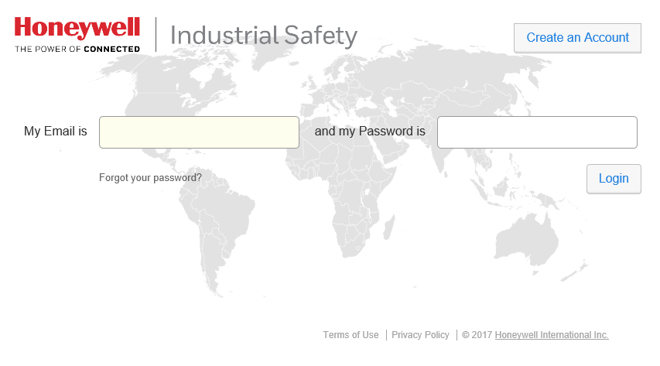
Distributor Media Library
Access to high resolution images and other marketing tools
https://honeywell.northplains.com/login
Browse, Search and Filter for available assets
Notes:
Honeywell Industrial Safety Distributor Media Library
Thank you for using the Industrial Safety Media Library! This tool is available to RSMs and Channel Partners of Honeywell needing access to high resolution images and other marketing tools.
You can login or request access to the Media Library by visiting https://honeywell.northplains.com/login/.
The Distributor Library provides Gas Detection distributors and partners with a streamlined user interface that is easy-to-use to access the latest materials that support Gas Detection products. The site includes search enhancements making it easier to find product images and other marketing tools.
Upon approval of account request, users will receive an email confirming the account approval. Once confirmed, users will gain access to the regional assets. A useful User Guide is available in the ‘Tools’ Tab once users log-in into the Media Library.

Slide 13
Six Easy Steps to Leverage Co-Op Funds
Formulate Project Idea
Complete & Submit Project Request Form or Annual Marketing Plan
Receive Approval from Co-Op Admin and Proceed with Creative / Design Work
Implement Requested Changes and Execute Project
Submit Claim and Proof of Performance to Co-Op Admin
Submit Draft Materials for Proofing
Keeping Things Simple
Notes:
Accessing your Allowable Co-Op Funds is easy. There are 6 easy steps.
Formulate your project idea
Submit your project request form or annual marketing plan. Our Co-Op Admin will receive the request, review it against the program guidelines and your available funds and let you know if the request is approved, denied or more info is needed.
Once you receive approval to proceed…work with your team to develop the necessary collateral.
We do need to review draft material to ensure that the content, images and logos align with our brand standards.
We’ll provide feedback and requested changes. We expect you make the appropriate changes and the execute your projects.
Within 30 days of completion, submit your claim and the adequate proof of performace.
That’s it.

Slide 14
The Project Approval Process
Submit a Project Request Form or Annual Marketing Plan
  Project Request Form – details individual project requests
  Annual Marketing Plan – lists all projects in the year where Co-Op funds will be requested
  Having either an approved Project Request for or Approved Annual Marketing Plan is a requirement – no exceptions!
  Forms located at: http://go.honeywellsafety.com/MAPform
  Submit completed forms to: honeywelliscoop@honeywell.com by September 1, 2018. No requests will be considered after this date.
Submit Project Requests As Needed or Just Once
Notes:
If we focus on step 2 there are a few things to highlight:
You can submit a project request forms as needed or you can plan your year in advance. The image on this slide shows a clip of the actual marketing plan template. It is very easy to use if you have the ability to create your annual plan at one time. Note you have to submit one or the other. No claims will be processed without an approved project request form or annual marketing plan on file.
All forms are located on our website.
All completed forms should be sent to the email listed on the screen by 9/1/2018. We will not consider any Co-Op Project requests that come in after that time.

Slide 15


The Claims Process
No claim will be paid without an approved Project Approval Form on file
Only claims submitted within 30 days of project completion AND no later than October 31, 2018 will be considered
  The only exception is for pre-approved projects targeted for November and December
An invoice and adequate proof of performance required for claim approval
Claims paid in form of credit memo only
Need Approved Project, Invoice and Adequate Proof of Performance
Notes:
If we jump ahead now to where your project has been executed and now you are ready to submit a claim…here is what you need to know.
…address bullets

Slide 16
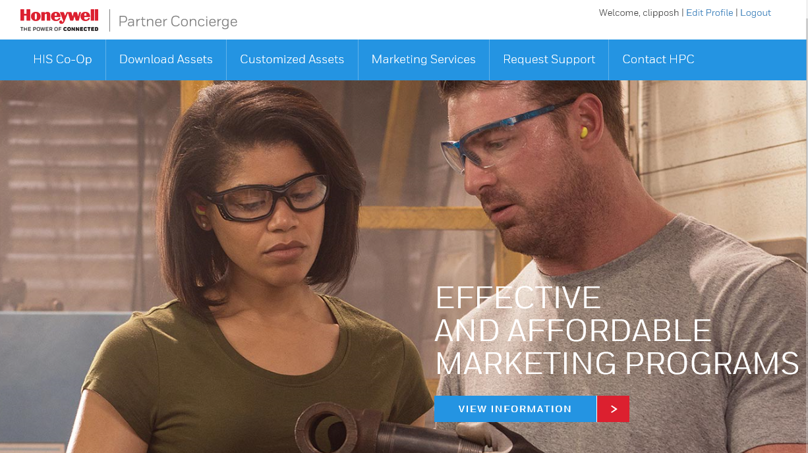
Intro to Honeywell Partner Concierge (HPC)
Website developed for HIS Partners, backed by professional marketing agency
Allows you to:
  Download HIS Marketing collateral for free
  Customize Collateral for Free
  Request quotes for custom projects
Expanding Your Agency Network
Notes:
I mentioned at the beginning of this call, we would be introducing you to a new service called Honeywell Partner Concierge. We will be providing a lot of details about this new service in a few minutes, but here is a summary about HPC.
…address bullets

Slide 17
Why Choose HPC
 | Member | HPC | HIS
Request a Custom Project
Provide a SOW & Quote
Approve project and Quote
Cut PO
Invoice for Work
Pay for work
Submit Invoice and Proof of Performance to HIS
Issue Credit
Discounted Agency Rates
Quick Turn Times
Use Co-Op Funds more effectively
  100% Reimbursement on approved marketing projects through HPC
  50% reimbursement rate for projects using other vendors
HPC makes it easy
  Custom Project Request Form on HPC doubles as Project Request form – HPC passes it to Co-Op Administrator
  No need to submit draft materials for proofing review
    HPC is an extension of our Marcom Team, well trained in Brand Standards
  HPC drives the claims process
    Provides Invoice and Proof of Performance
You’ll Hear More about HPC Soon!
Notes:
It’s important to understand why you should consider using HPC.
…address bullets
On the right side of the screen you’ll see the table addresses the process for working with HPC. If you hire them for any custom projects – it is just like working with any other approved vendor in your system. You receive a quote, cut them a PO, pay them and the HIS processes the Co-Op Claim request and credits your account.

Slide 18
Final Program Reminders
Project Requests
  Eligible partners will have until 9/1/18 to submit project requests for approval. No project requests will be considered after this date.
  Unused funds will not be rolled over for use in the next calendar year.
Claims
  No claims paid without an approved Pre-approval Form on file and copy of original invoice and adequate proof of performance.
  Claims must be submitted within 30 days of completion.
  Claims will be paid in form of a credit memo only
Other
  HPC is paid like any other vendor – then invoice / POP submitted for claim reimbursement.
  Still use HSP Medial Library for images
Contacts
  Co-Op Program Contact: honeywelliscoop@honeywell.com
  HPC Contact: honeywell@partnerconcierge.com
Co-Op Program Information: https://go.honeywellsafety.com/MAPform
  For Distributor Advertising Guidelines
  Forms
  Program Guidelines
  Program Brochures
HSP Media Library
  https://honeywell.northplains.com/login/
Honeywell Partner Concierge
  http://is.partnerconcierge.com/
Point of Purchase displays
  www.hspinstore.com
Bookmark the Website!
Notes:
In conclusion, there are some key take aways to remember.
…Read bullets
Also on the right side of the screen you will see contacts for both the HIS Co-OP and HPC. Note they are different. Please direct your questions to the right contact!
And as always – bookmark the https://gohoneywellsafety.com/MAPform website. It has things like the program guidelines, advertising guidelines, Forms and program brochures available today. Also – this recorded session will be available here soon as well.

Slide 19
Honeywell Partner concierge
1H18
Services Overview
Notes:
At this point I’d like to introduce Walter Mikalean from Sphere Enterprises. Walter will introduce you to Honeywell Partner Concierge and give you a demo of the site!

Slide 20
Honeywell Partner Concierge (HPC) Overview
HPC is a web-site, backed by a full service marketing agency that is available to support Honeywell partners with marketing tools, resources, and the support structure required to develop and execute ROI driven marketing programs quickly and cost efficiently.
Invite only to HIS Partner Program Members
Download FREE marketing collateral for use with your sales people or customers Request your FREE customized collateral (add your logo and contact information and have PDF returned in 48 hours!
Request custom projects that can help execute your marketing strategy!
Why is this Important?
  Partners wanted more from HIS
  Maximize marketing investments – leverage high quality materials that exist and are easily available
  Get to market faster with materials that exist and are easily customized
  Utilize Co-Op Funds on all HPC marketing campaigns and services and reimbursed at a high rate.
  Wide range of marketing support services for your custom project needs!
https://is.partnerconcierge.com

Slide 21

Why use HPC Services?
Special pricing and volume discounts on all marketing services.
Dedicated marketing team uniquely attuned to partner business offerings expertise, insight, and assistance.
ROI driven custom developed marketing programs, services and solutions to maximize partner marketing budget and sales efforts.
Wide range of marketing tools, resources and custom industry campaigns to support partner specific sales and marketing objectives.

Slide 22










References
“Since 2010, HPC has been a valuable asset to our marketing department. From industry-specific lead generation and brand strengthening campaigns to Honeywell focused product promotions, HPC provides the tools we need to plan, develop, and execute our integrated campaigns on time and on budget.
We highly recommend HPC for Honeywell marketing activities.”
Jody C
Director of Marketing
Barcoding, Inc.
Happy Clients!

Slide 23





Free Collateral and Customization Services
Free to HIS Partner Program Members
  Honeywell collateral for download
  Customization Services
Guidance for New Authorized Distributor Logos
“The printer campaign is doing very well. We have had a dozen or so printers replaced with sales resulting from the first few emails.”
Janet J
Director of Marketing
Peak-Ryzexm Inc,
Making it Easy to Use Existing Tools!
Notes:
Feel free to use this slide on your partners

Slide 24

Portfolio of Services
Marketing Services
  Email development and execution
  Business blogging and marketing
  SEO/PPC planning and execution
  Website design and updates
  Website and SEO evaluation
  Brochure and collateral development
  Marketing planning and consultation
  Video editing and production
Sales Support Services
  Lead and prospect nurturing
  Appointment setting campaigns
  Prospect profiling campaigns
  Integrated lead generation
  Telemarketing/lead qualification
  Multi-touch email marketing
  End-user database scrub and append
  Database append services
Helping Honeywell Partners to Grow

Slide 25
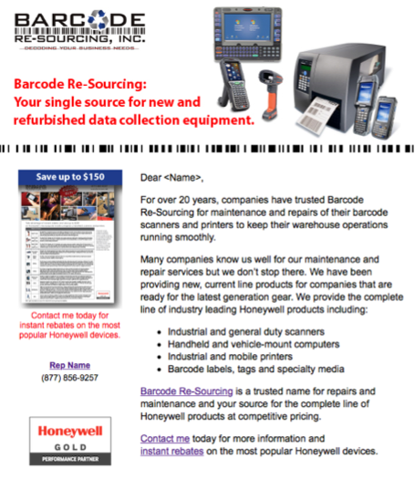
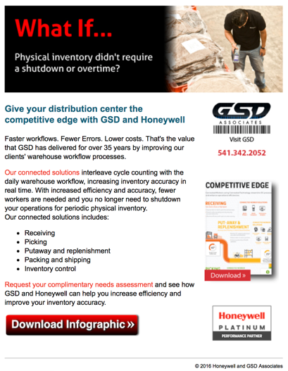
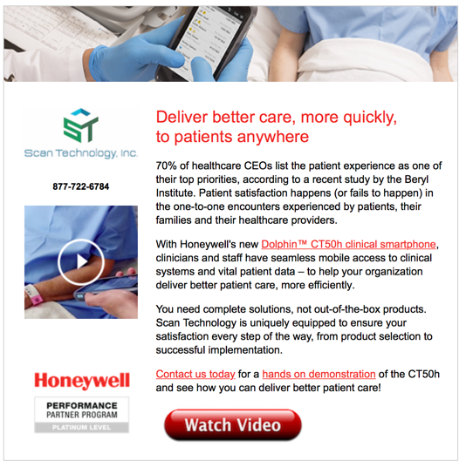
Popular Request – Email Marketing
Lead generation and sales engagement
Sales rep branded relationship building
Monthly drip marketing and awareness
Newsletter and awareness building
Online survey and opinion polls
Landing page development and hosting
Social media integration and promotion
Average Response Rates
16% Nurture / Installed Prospects
2% New Prospects

Slide 26
Popular Request – Telemarketing
Appointment setting
Sales lead qualification
Inbound response and lead qualification
Webinar and event recruitment
Post event follow-up and lead qualification
Customer survey and account profiling
List development and cleansing
“Thank you for the great sales leads from the marketing campaign. I have arranged two meetings and attended one that has yielded an opportunity for 5 APs and 30 scanners just from the first lead. My second meeting is next Tuesday on site with a new prospect. Keep the leads coming…”
John G
Sr. Account Manager
Computer Support Services, Inc.
Average Response Rates*
12% Nurtured / Installed Prospects
3% New Prospects

Slide 27
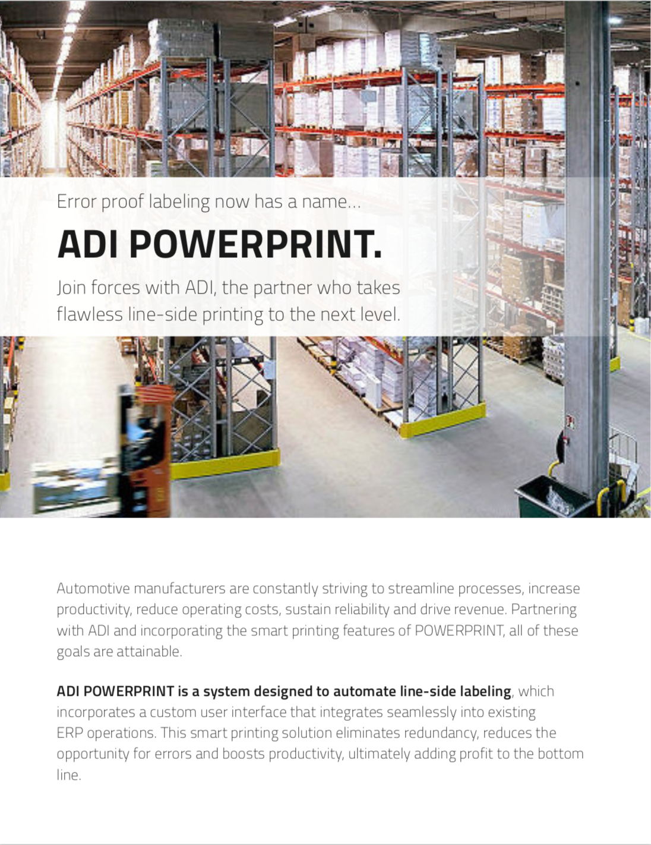
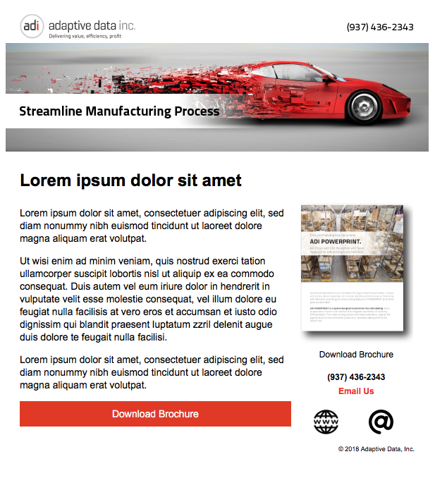

Sample Pricing
Sales Brochure
$750 – $1,500
Email
$450 – $750
Advertising (print or digital)
$500 – $900
HPC does also offer Printing Services for an additional cost
Easy to Digest Prices!

Slide 28

Remember
Use Co-Op Funds to pay for projects
Reimbursement rate of 100% on approved, co-marketed projects versus 50% rate
Process exists for working directly with Co-Op Administrator on submitting your Project Pre-Approval and communicating the Fund Request amount

Slide 29
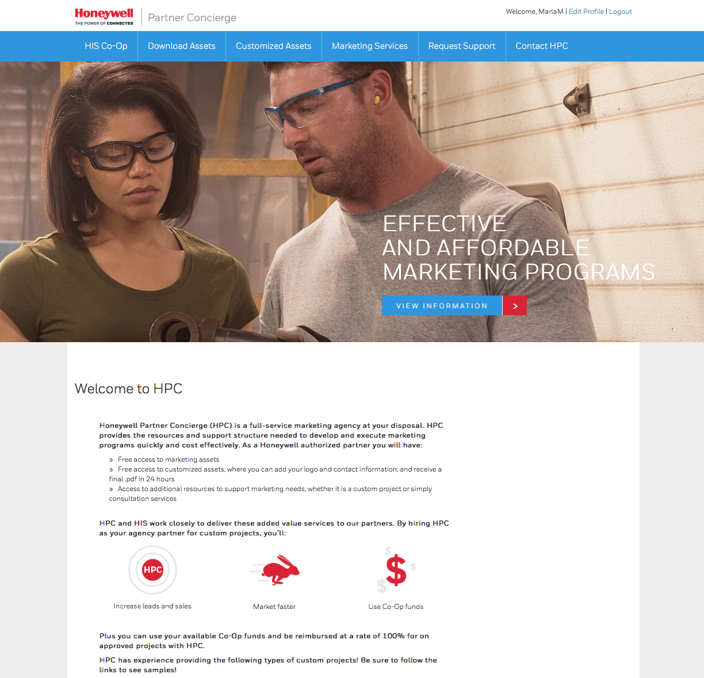
Demo
Demo ➢

Slide 30

Final Thoughts and Q&A
Expect email with files from this call and 2018 Co-Op Allowable funds within then next few weeks.
What Can We Clarify?
Notes:
Again – we appreciate your business and look forward to helping you drive more revenue for your business and Honeywell.
Now, any questions?

